Slide 1
CHARIOT – Holistic Management Architecture for IoT
Abhishek Dubey
Subhav Pradhan
Acknowledgement: Work was performed under a grant from Siemens, CT

Slide 2
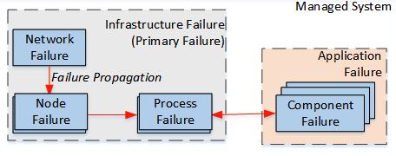
Failure model
Infrastructure failure
Network failure
Node failure
Device failure
Process failure
Application failure
Application component failure

Slide 3
A Resilient Deployment and Reconfiguration Infrastructure
Why is a management infrastructure necessary?
Multi-tenancy means multiple, simultaneous applications
Dynamic nature means applications as well as resources can be added, removed, modified at runtime
Extensible CPS are often remotely deployed
System should be autonomous (closed loop)
Management infrastructure –> Autonomous controller
Extensible CPS -> Management system
A resilience and autonomous management infrastructure is key to attaining continuous evolution and operation
Desired behavior
Management Infrastructure
Observer behavior
Management Actions
Observers/ Monitors
Managed System
Functionalities

Slide 4
Key Requirements for a Resilient Management Infrastructure
Distributed group membership
Management entities in different nodes collectively manage distributed applications
Highly dynamic system so distributed management entities need to keep track of each other
New members joining
Existing member leaving/failing
Leader election
Each extensible CPS cluster should have a leader management entity
Prevents frequent consensus-based agreements
Leader responsible for instigating failure mitigation
Leader election required in case of leader failure
Deployment sequencing
Awareness of application dependencies
A client might want to wait until server is available
State preservation
Persistent storage of system state
Resources, applications related information, constraints
Management infrastructure should be stateless
Any relevant information (managed applications) should be stored persistently

Slide 5
Solution Approach: Overview
Responsible for failure detection. Detect failure of processes related to different management entities (DM). Same mechanism used to detect Node failure. If a node fails, its DM process fails.
Collection of Deployment Managers (DMs) form a management infrastructure responsible for management (deployment and configuration, as well as re-configuration) of applications
Notes:
Current prototype implementation focused only on node failure so we assumed that DM process failure means node failure. Easily distinguishable if node status checked after DM failure.
To handle DM process failure, some of its state (applications being managed) should be made persistent (file system or database).

Slide 6
Self-reconfiguration Mechanism For Autonomous Resilience (FA-3)
Addresses Challenge 2
Requirement: Ensure extensible CPS facilitate autonomous resilience of distributed applications
Any solution should help with
Failure avoidance
Failure management
Operations management
CHARIOT: A holistic solution for managing extensible CPS
Contribution 1: Design-time tool to model extensible CPS
Contribution 2: Well-defined data model to store system information
Contribution 3: Runtime management infrastructure that implements a self-reconfiguration mechanism using a closed sense-plan-act loop

Slide 7
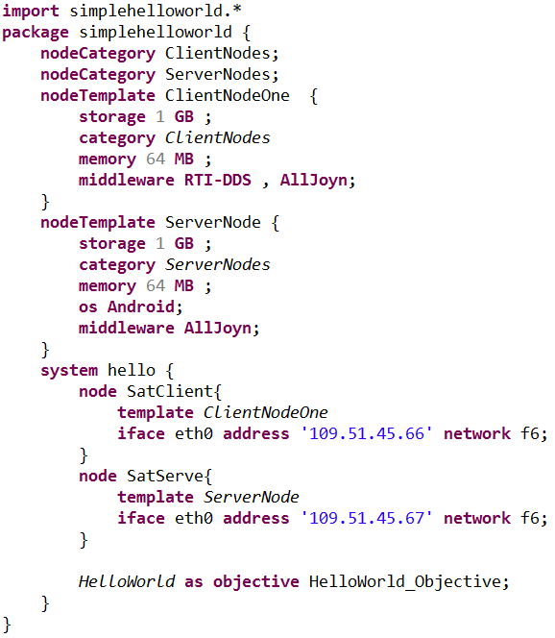

When Should a System Reconfigure?
Managed system
1
Failure
detection
1
3
Hardware update
detection
Reconfiguration
Reconfiguration triggers required for following events
Failures
Updates
Hardware updates
Software updates
2
Monitoring Infrastructure
Failure trigger
Management Engine
2
Hardware update
trigger
System model
2
Software update
trigger (manual)
Software update
1
Notes:
Detection: Sensing | Management Engine: Planning | Reconfiguration: Acting phase

Slide 8
Literature Review
Conventional fault-tolerance technique used for systems with high availability requirements
Active/passive replication, Recovery blocks
Masks failures that occurs in one or more (but not all) redundant copies
Does not “adapt” system
By itself, not sufficient
Not feasible to deploy redundant copy of every component
Even components with redundancy can withstand limited failures
Redundancy
based
Used by Akka (toolkit and runtime) and Erlang (language and runtime)
Uses hierarchical supervisor structure
Failure of a node results in notification to the (parent) supervisor that can
Stop, restart, propagate failure upwards
Limited recovery actions available (e.g.: migration not supported)
Resilience
Supervisor pattern
Recovery plan explicitly encoded at design-time
E.g.: Different policy-based approaches
Fast but cannot be used for dynamic systems
Cannot foresee all failures and evolution at design-time
Offline
Reconfiguration based
Online
Notes:
In general, reconfiguration-based approaches perform sense-plan-act loop

Slide 9
Literature Review
Online Reconfiguration-based Approaches
Proposes a concept similar to ours. Runtime checking of feature models for variability management.
No specific implementation
Does not support updates
Rafael Capilla, Jan Bosch, Pablo Trinidad, Antonio Ruiz-Cortes, and Mike Hinchey. An overview of dynamic software product line architectures and techniques: Observations from research and industry. The Journal of Systems and Software, pages 3-23, 2014.
O. Höftberger and R. Obermaisser, "Ontology-based runtime reconfiguration of distributed embedded real-time systems", Proc. of the 16th IEEE International Symposium on Object/Component/Service-Oriented Real-Time Distributed Computing (ISORC 2013), 2013.
Marisol García Valls, Iago Rodríguez López, and Laura Fernández Villar. iland: An enhanced middleware for real-time reconfiguration of service oriented distributed real-time systems. Industrial Informatics, IEEE Transactions on, 9(1):228–236, 2013.
Grouping components together based on their services and interaction semantics. Upon failure of a component, finding a substitute.
Solution searched at runtime but resilience solely supported via functional redundancy
Does not support updates
A middleware that supports timely reconfiguration. Application graph contains service requirements and dependency. Expanded graph contains different service implementation. These graphs composed and optimized at design-time; searched at runtime.
Does not support updates (graphs optimized at design-time so does not change at runtime)

Slide 10
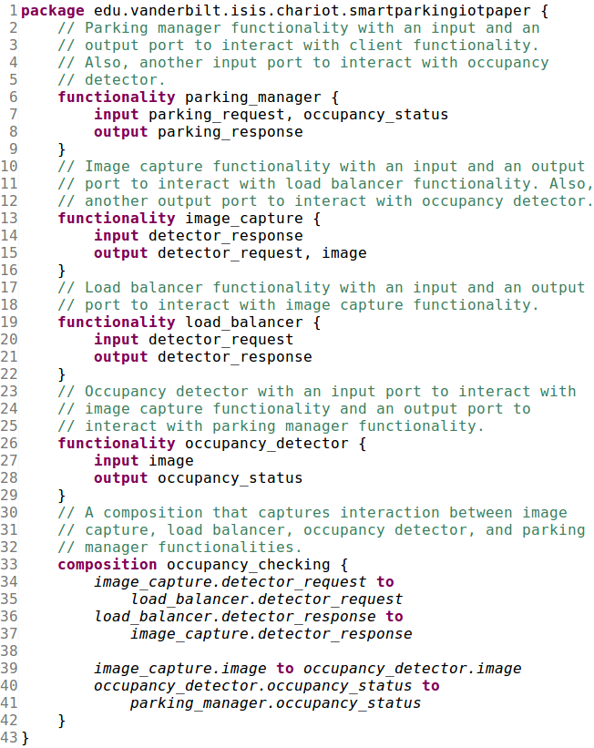
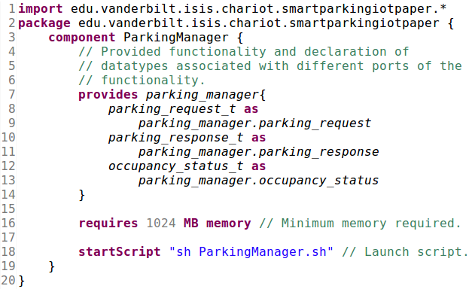
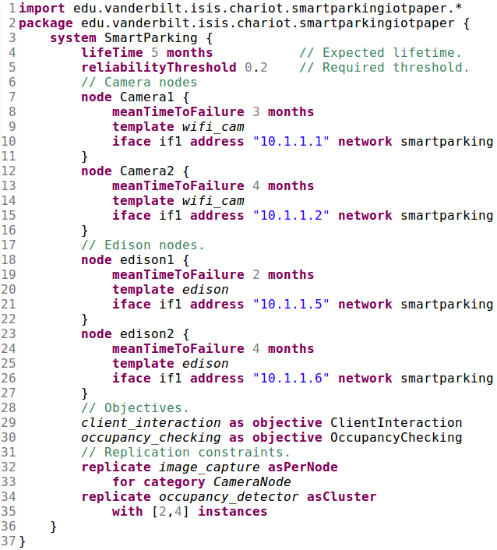
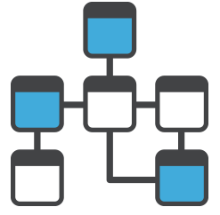
CHARIOT: Introduction
CHARIOT (Cyber-pHysical Application aRchItecture with Objective-based reconfiguraTion) is a holistic solution for managing extensible CPS
CHARIOT comprises of entities that can be classified into three layers:
Design layer: DSML (Domain-Specific Modeling Language) to model systems, and interpreters to retrieve information from system models
Data layer: Codifies the format in which system information (comprises design-time system description and runtime system representation) must be stored
Management layer: Facilitates autonomous resilience by implementing a self-reconfiguration mechanism
Design layer
Design-time
system description
Resilient data store
Data schema
Data layer
Data Store
Data Store
Runtime system representation
Monitoring Infrastructure
Deployment Infrastructure
Management Engine
Management layer
Notes:
Data layer helps decouple the design layer from the management layer

Slide 11
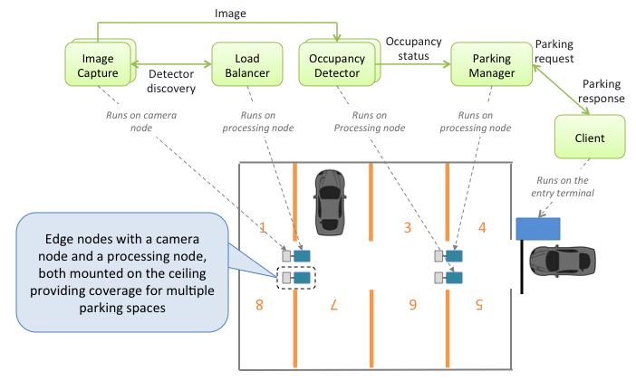
Use Case: A Smart Parking System
A Smart Parking System that Monitors and Assigns Parking Spaces to users

Slide 12
CHARIOT-ML: A Modeling Tool for Extensible CPS
Requirements for a modeling tool for extensible CPS
Being able to describe systems by capturing generic information (e.g., properties, provisions, requirements, and constraints)
Avoid explicit management directives (e.g., if node A fails, move all components to node B)
Management action should be “searched” at runtime using available system information
Ensure flexibility to support updates
CHARIOT-ML is a textual ML built using the Xtext framework
G
Goal description
Application Goals
Hardware resources
O₁
O_{n}
Component types
Contains
Contains
Node Categories
Replication Constraints
Objectives
F₁
F₂
F_{n}
Contains
Associated
with
Contains
Node Templates
Tied to
Functionalities
Component Types
C₁
C₂
C₃
C_{n}
Provides
Modeling concepts in CHARIOT-ML
Goal-based System Description
Betty HC Cheng, Pete Sawyer, Nelly Bencomo, and Jon Whittle. A goal-based modeling approach to develop requirements of an adaptive system with environmental uncertainty. In International Conference on Model Driven Engineering Languages
Notes:
Runtime component instances are not modeled in CHARIOT-ML
Goal-based system description is basically a functionality decomposition tree (can provide high degree of flexibility – and/or tree)
This approach of goal-based system description is not novel as it has been previously presented

Slide 13
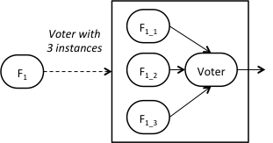
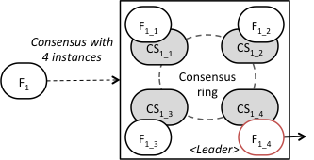
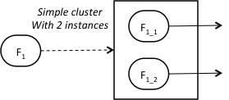
CHARIOT-ML: A Modeling Tool for Extensible CPS
CHARIOT-ML supports different kinds of replication constraints (that are associated with functionalities) to model redundancy
Voter replication pattern
Consensus replication pattern
Cluster replication pattern
Voter, consensus, and cluster patterns have associated redundancy factor
Explicit factor
Range-based factor
Redundancy with range-based factor can be used as a mechanism for failure avoidance
CHARIOT-ML also support per-node replication pattern
A per-node replication constraint replicates associated functionality on every node that belongs to the corresponding node category
Notes:
F: Functionality
CS: Consensus Service Provider

Slide 14
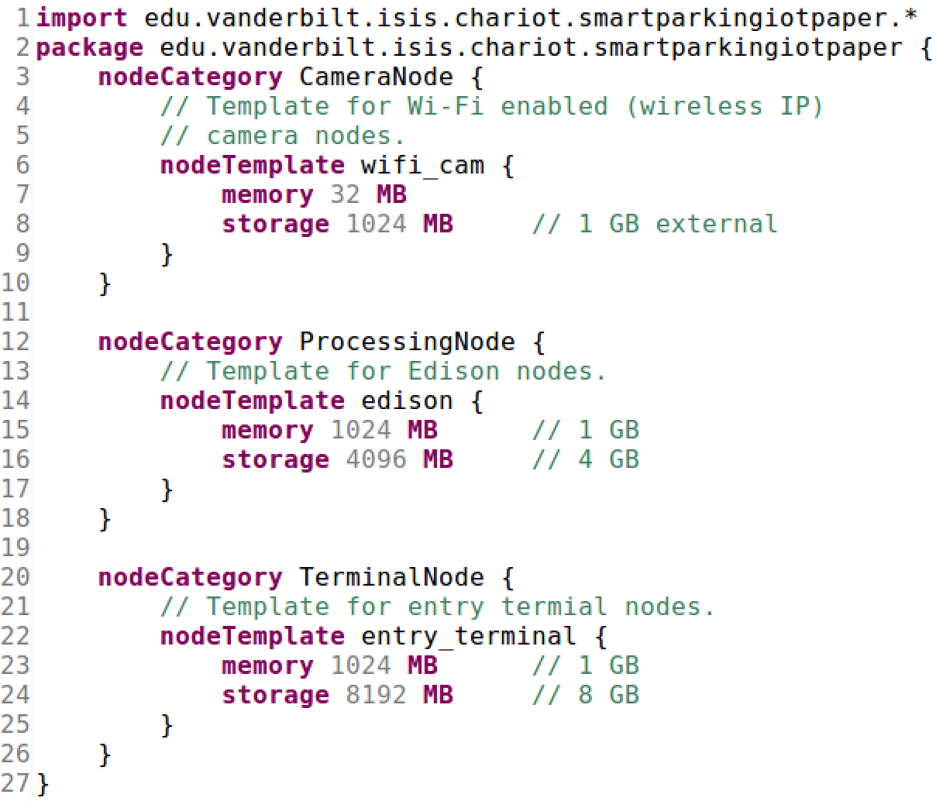
Modeling the Smart Parking System
Smart Parking
Goal
Occupancy Checking
Client Interaction
Objectives
Per node
Cluster[2,4]
image_ capture
load_ balancer
occupancy_
detector
parking_
manager
client
Functionalities
Image Capture Comp
Load Balancer Comp
Occupancy Detector Comp
Parking Manager Comp
Client Comp
Component types
Image Capture
Load Balancer
Occupancy Detector
Parking Manager
Client
Components
Hardware Description

Slide 15
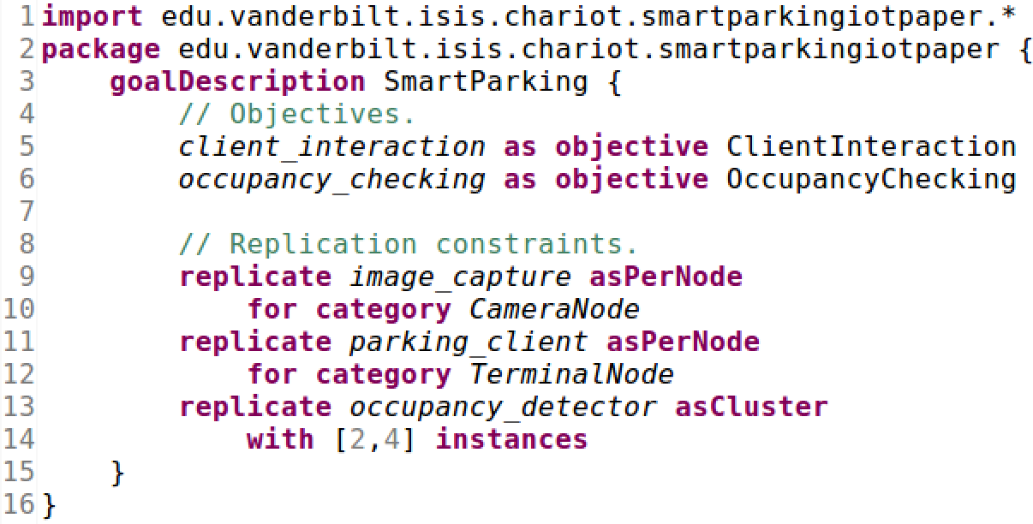
Modeling the Smart Parking System using CHARIOT-ML
Hardware Description
Application Goal Description

Slide 16
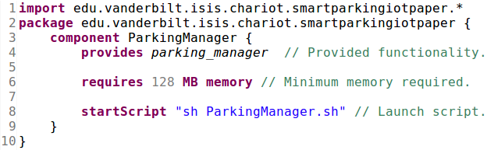
Modeling the Smart Parking System using CHARIOT-ML
Component Type Description
Functionality Description

Slide 17
CHARIOT Data Layer
A well-defined data model used to store system information
Design-time system description
Runtime system representation
Represents a schema that forms the basis for persistently storing system information in a backend database
CHARIOT currently uses MongoDB
Helps decouple the design layer from the management layer
A design layer can comprise any modeling tool that generates system descriptions based on the schema
A management layer can comprise entities that use the schema to read and update system information stored in the backend database
Design layer
Design-time
system description
Resilient data store
Data schema
Data layer
Data Store
Data Store
Runtime system representation
Monitoring Infrastructure
Deployment Infrastructure
Management Engine
Management layer

Slide 18
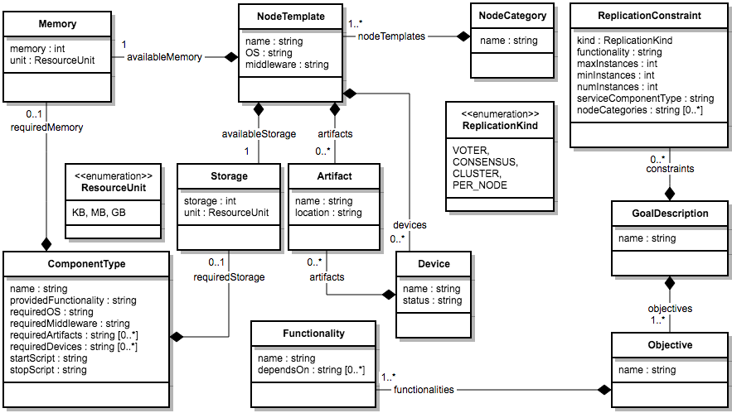
CHARIOT Data Layer
Schema to Store Design-time System Descriptions

Slide 19
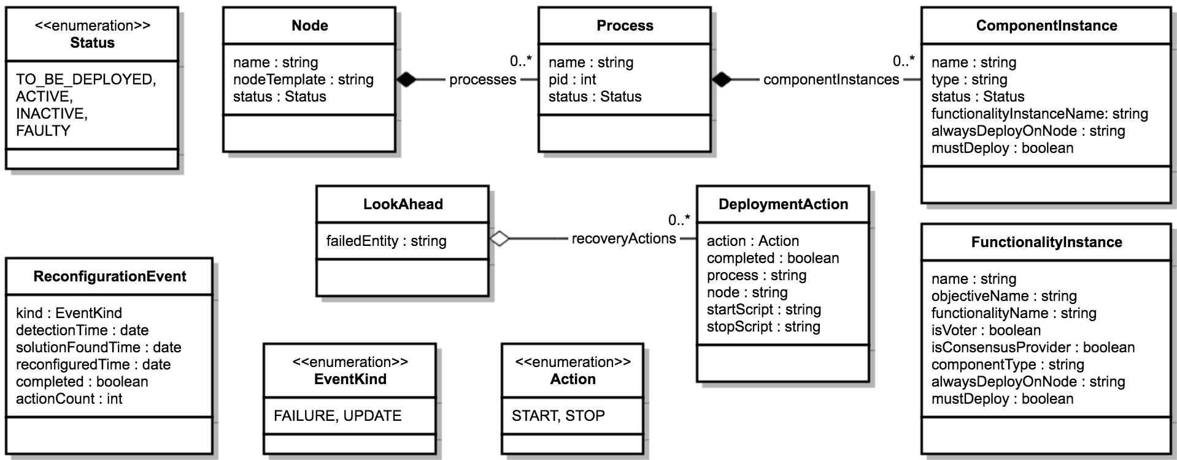
CHARIOT Data Layer
Schema to Store Runtime System Representations

Slide 20
CHARIOT Management Layer
Comprises the following entities to implemented a closed sense-plan-act loop
Monitoring Infrastructure
Management Engine
Deployment Infrastructure
Monitoring infrastructure implemented using ZooKeeper (Server, Clients, Membership watcher)
Collection of Deployment Managers (one on each edge/compute node) implements a deployment infrastructure capable of managing lifecycle of applications hosted on each node
The Management Engine is implemented using Z3, a Satisfiability Modulo Theories (SMT) solver
Responsible for planning reconfiguration actions
Modeling the problem of reconfiguration by encoding a set of complex SMT constraints
Management layer
Managed system
Monitoring Infrastructure
Detect
failure
Execute
reconfiguration
actions
Initiate reconfiguration
Deployment Infrastructure
Management Engine
Send
reconfiguration plan
Notes:
I would like to thank Dr. Tihamer for the initial work he did in implementing some of the SMT constraints that are currently used in CHARIOT.

Slide 21
Management Engine Self-Reconfiguration Logic
Management Engine responsible for the planning phase
Dynamically searching reconfiguration actions at runtime
Uses the concept of configuration space and configuration points
A configuration space represents all possible states a system can attain
Each possible state is a configuration point
A configuration space can have multiple configuration points
Reconfiguration involves transitioning from one configuration point to another in the same configuration space
Initial configuration point
Fault disables part of space
New configuration point
Reconfiguration (system recovered)
Another fault
New configuration point
Reconfiguration (system recovered)
Configuration Space of an extensible CPS
Notes:
Configuration space includes
Goal descriptions
Goal-based System Description modeled at design-time
Replication constraints corresponding to redundancy patterns
Component types
Available resources
Different categories of nodes and their properties
A configuration space can have multiple configuration points
A configuration point represents a valid configuration of all applications that are part of the system represented by the configuration space
One-to-one mapping between required component instances and available resources

Slide 22
Configuration Point Computation (CPC) Algorithm
Component instances not modeled, so needs to be computed
Compute functionality instances based on system description provided at design-time
Compute component instances based on functionality instances
Map functionality instances to component types
Determine dependencies between component instances
Phase 1: Instances computation phase
Phase 2: Constraints encoding phase
Encoding SMT constraints using component instances, their dependencies, and available resources
Forms the problem space for the Z3 solver
Phase 3: Solution computation phase
Invoke Z3 solver using encoded constraints
Solver output non-deterministic, so apply least distance heuristic to compute optimal solution

Slide 23
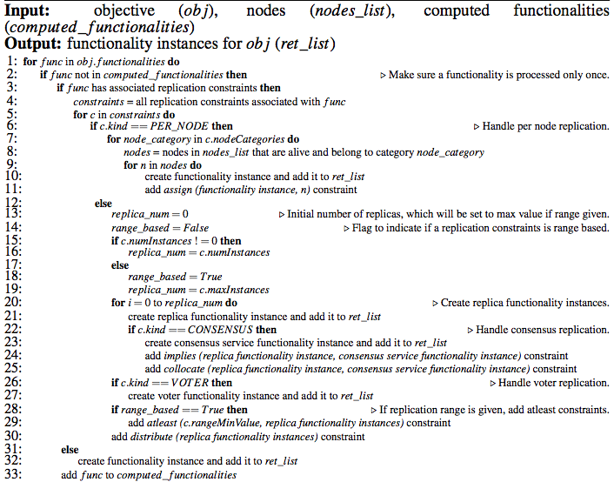
Functionality Instance Computation

Slide 24
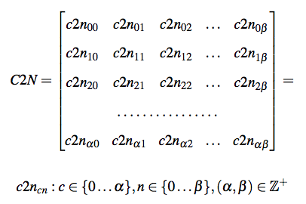
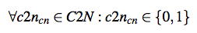
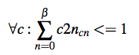
CHARIOT Encoded Constraints
Nodes
Since reconfiguration involves transitioning from one configuration point to another, constraints that represent a configuration point are of utmost importance
Constraints to ensure component instances that must be deployed are always deployed
Constraints to ensure component instances that communicate with each other are either deployed on the same node or on nodes that have network links between them
Constraints to ensure resources provided-required relationships are valid
Constraints to ensure proper management of component instances that are part of a replication group
Constraints to represent failures, such as node failures
Component instances
Notes:
c2ns are Z3 integer variables

Slide 25
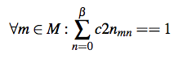
CHARIOT Encoded Constraints
Nodes
Since reconfiguration involves transitioning from one configuration point to another, constraints that represent a configuration point are of utmost importance
Constraints to ensure component instances that must be deployed are always deployed
Constraints to ensure component instances that communicate with each other are either deployed on the same node or on nodes that have network links between them
Constraints to ensure resources provided-required relationships are valid
Constraints to ensure proper management of component instances that are part of a replication group
Constraints to represent failures, such as node failures
Component instances
Notes:
c2ns are Z3 integer variables

Slide 26
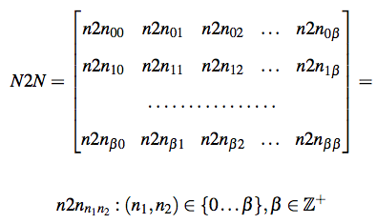
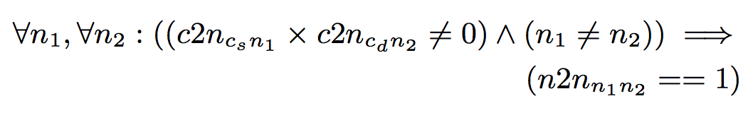
CHARIOT Encoded Constraints
Since reconfiguration involves transitioning from one configuration point to another, constraints that represent a configuration point are of utmost importance
Constraints to ensure component instances that must be deployed are always deployed
Constraints to ensure component instances that communicate with each other are either deployed on the same node or on nodes that have network links between them
Constraints to ensure resources provided-required relationships are valid
Constraints to ensure proper management of component instances that are part of a replication group
Constraints to represent failures, such as node failures
Nodes
Nodes
Let c_{s} and c_{d} be two component instances with inter-dependency
Notes:
n2ns are integers that are either 1 or 0

Slide 27
CHARIOT Encoded Constraints
Since reconfiguration involves transitioning from one configuration point to another, constraints that represent a configuration point are of utmost importance
Constraints to ensure component instances that must be deployed are always deployed
Constraints to ensure component instances that communicate with each other are either deployed on the same node or on nodes that have network links between them
Constraints to ensure resources provided-required relationships are valid
Constraints to ensure proper management of component instances that are part of a replication group
Constraints to represent failures, such as node failures

Slide 28
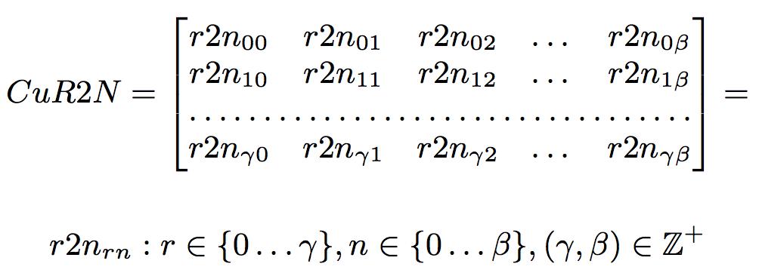
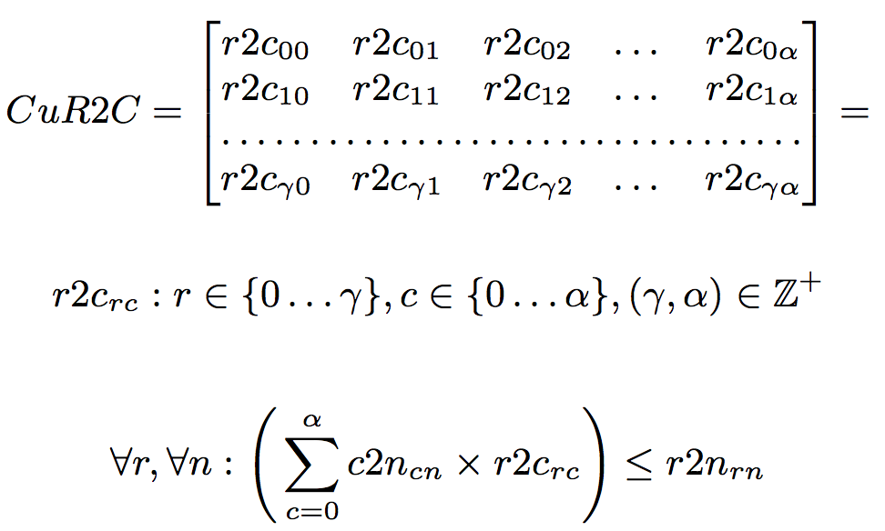
CHARIOT Encoded Constraints
Since reconfiguration involves transitioning from one configuration point to another, constraints that represent a configuration point are of utmost importance
Constraints to ensure component instances that must be deployed are always deployed
Constraints to ensure component instances that communicate with each other are either deployed on the same node or on nodes that have network links between them
Constraints to ensure resources provided-required relationships are valid
Constraints to ensure proper management of component instances that are part of a replication group
Constraints to represent failures, such as node failures
Nodes
Cumulative
resources
Component instances
Cumulative
resources

Slide 29
CHARIOT Encoded Constraints
Since reconfiguration involves transitioning from one configuration point to another, constraints that represent a configuration point are of utmost importance
Constraints to ensure component instances that must be deployed are always deployed
Constraints to ensure component instances that communicate with each other are either deployed on the same node or on nodes that have network links between them
Constraints to ensure resources provided-required relationships are valid
Constraints to ensure proper management of component instances that are part of a replication group
Constraints to represent failures, such as node failures

Slide 30
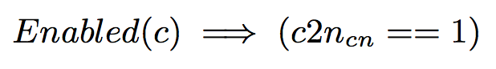
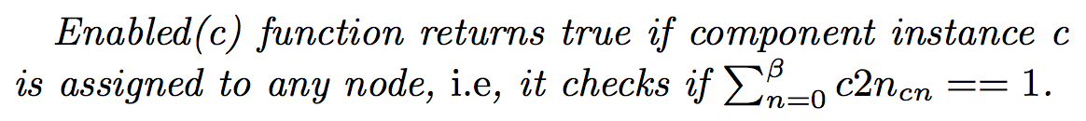
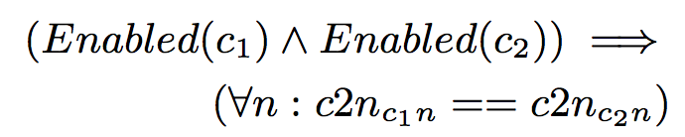
CHARIOT Encoded Constraints
Since reconfiguration involves transitioning from one configuration point to another, constraints that represent a configuration point are of utmost importance
Constraints to ensure component instances that must be deployed are always deployed
Constraints to ensure component instances that communicate with each other are either deployed on the same node or on nodes that have network links between them
Constraints to ensure resources provided-required relationships are valid
Constraints to ensure proper management of component instances that are part of a replication group
Constraints to represent failures, such as node failures
Assign constraint for per-node replication
Let c be a component instance that should be assigned to a node n
Collocate constraint to collocate component instances and their consensus service providers
Let c₁ and c₂ be two component instances that
needs to be collocated

Slide 31
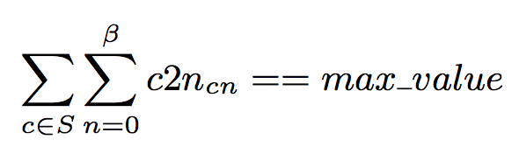
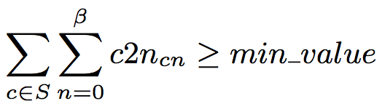
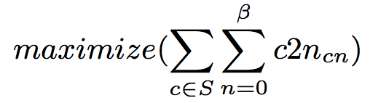
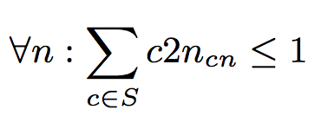
CHARIOT Encoded Constraints
Since reconfiguration involves transitioning from one configuration point to another, constraints that represent a configuration point are of utmost importance
Constraints to ensure component instances that must be deployed are always deployed
Constraints to ensure component instances that communicate with each other are either deployed on the same node or on nodes that have network links between them
Constraints to ensure resources provided-required relationships are valid
Constraints to ensure proper management of component instances that are part of a replication group
Constraints to represent failures, such as node failures
For range-based replications, ensure “M out of N” semantics
Initial deployment:
Non-initial deployments: Use at-least constraint
Ideal solution:
Distribute constraint to ensure replicas are always deployed on different nodes
Notes:
max_value == alpha
Can’t use maximize as optimization in Z3 still in experimental phase so doesn’t scale

Slide 32
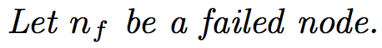
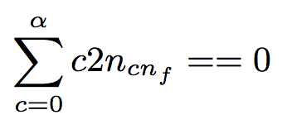
CHARIOT Encoded Constraints
Since reconfiguration involves transitioning from one configuration point to another, constraints that represent a configuration point are of utmost importance
Constraints to ensure component instances that must be deployed are always deployed
Constraints to ensure component instances that communicate with each other are either deployed on the same node or on nodes that have network links between them
Constraints to ensure resources provided-required relationships are valid
Constraints to ensure proper management of component instances that are part of a replication group
Constraints to represent failures, such as node failures

Slide 33
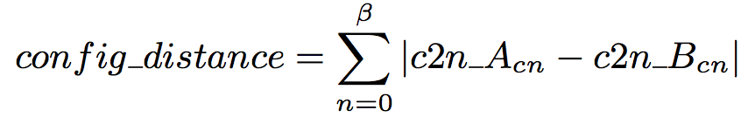
Least-distance Heuristics
Part of the third phase of the CPC algorithm
Results in a solution that is the least distance away from current configuration point
Distance between two configuration points is the distance between their corresponding C2N matrices
Iterative solution where we keep asking solver to provide a solution with less distance than the previous solution
Iteration stops when no solution with less distance is found
Take solution from previous iteration as the best solution
Ideal solution would be to use Z3’s minimize optimization
Like maximize optimization, this does not scale as optimization in Z3 is in experimental phase

Slide 34
Look-ahead Re-Configuration
CPC algorithm by default computes reconfiguration solutions after failures or updates (reactive approach)
Incurs solution computation time
Not an ideal solution for hard real-time systems
For failures, solution can be pre-computed at runtime (look-ahead approach)
CHARIOT currently uses a single-step look ahead for node failures
Assume each node to have failed
Invoke the default CPC algorithm
Store solution in the database
When a node eventually fails, solution computation time is same as database lookup time!
Single-step look-ahead approach cannot be used for systems that experiences bursts of failures
Time to pre-compute solutions < time between any two consecutive failures
Multi-step look-ahead approach can be used for such systems
An ideal solution would be to parameterize the number of look-ahead step and adjust that value based on runtime behavior of a system
Notes:
Look-ahead approach is an extension of the CPC algorithm
Look-ahead approach cannot be used for update events

Slide 35
CHARIOT Runtime Implementation
A daemon responsible for managing application lifecycle (spawn/kill a process)
A server node that hosts a ZooKeeper Server and a ZooKeeper Membership Watcher
A ZooKeeper Client
Compute node
Heartbeat
Monitoring Server
A server node that hosts a MongoDB Server
Platform services
Node Monitor
Deployment Manager
Config space update
Database
Server
Application
Failure notification
Management commands
Query/ Update
Communication Middleware
A server node that hosts a CHARIOT Management Engine
Operating System (Includes device drivers)
Management Engine
Hardware (Includes sensors and actuators)
Server nodes
Done using ZeroMQ
Notes:
Current implementation of CHARIOT does not use a well-defined component model
A component is equivalent to a process
Different server nodes not a single point of failure as they can be replicated easily

Slide 36
Experiment Test-bed
Edge nodes and servers emulated using Ubuntu Virtual Machine in a OpenStack-based private cloud
Total of 48 VMs used
45 VMs with 1 GB RAM, 1 VCPU, and 10 GB disk to emulate edge nodes
3 VMs with 4 GB RAM, 2 VCPUs, and 40 GB disk to emulate monitoring server, database server, and management engine
Smart Parking System used as application
Deployed as a per-node replication group
Deployed as a cluster replication group with range (7, 10)
Deployed as a per-node replication group
Image
Occupancy status
Parking
request
Image Capture
Load
Balancer
Occupancy Detector
Parking Manager
Client
Detector discovery
Parking
response
Runs on camera node
Runs on
processing node
Runs on
processing node
Runs on processing node
Runs on terminal node

Slide 37
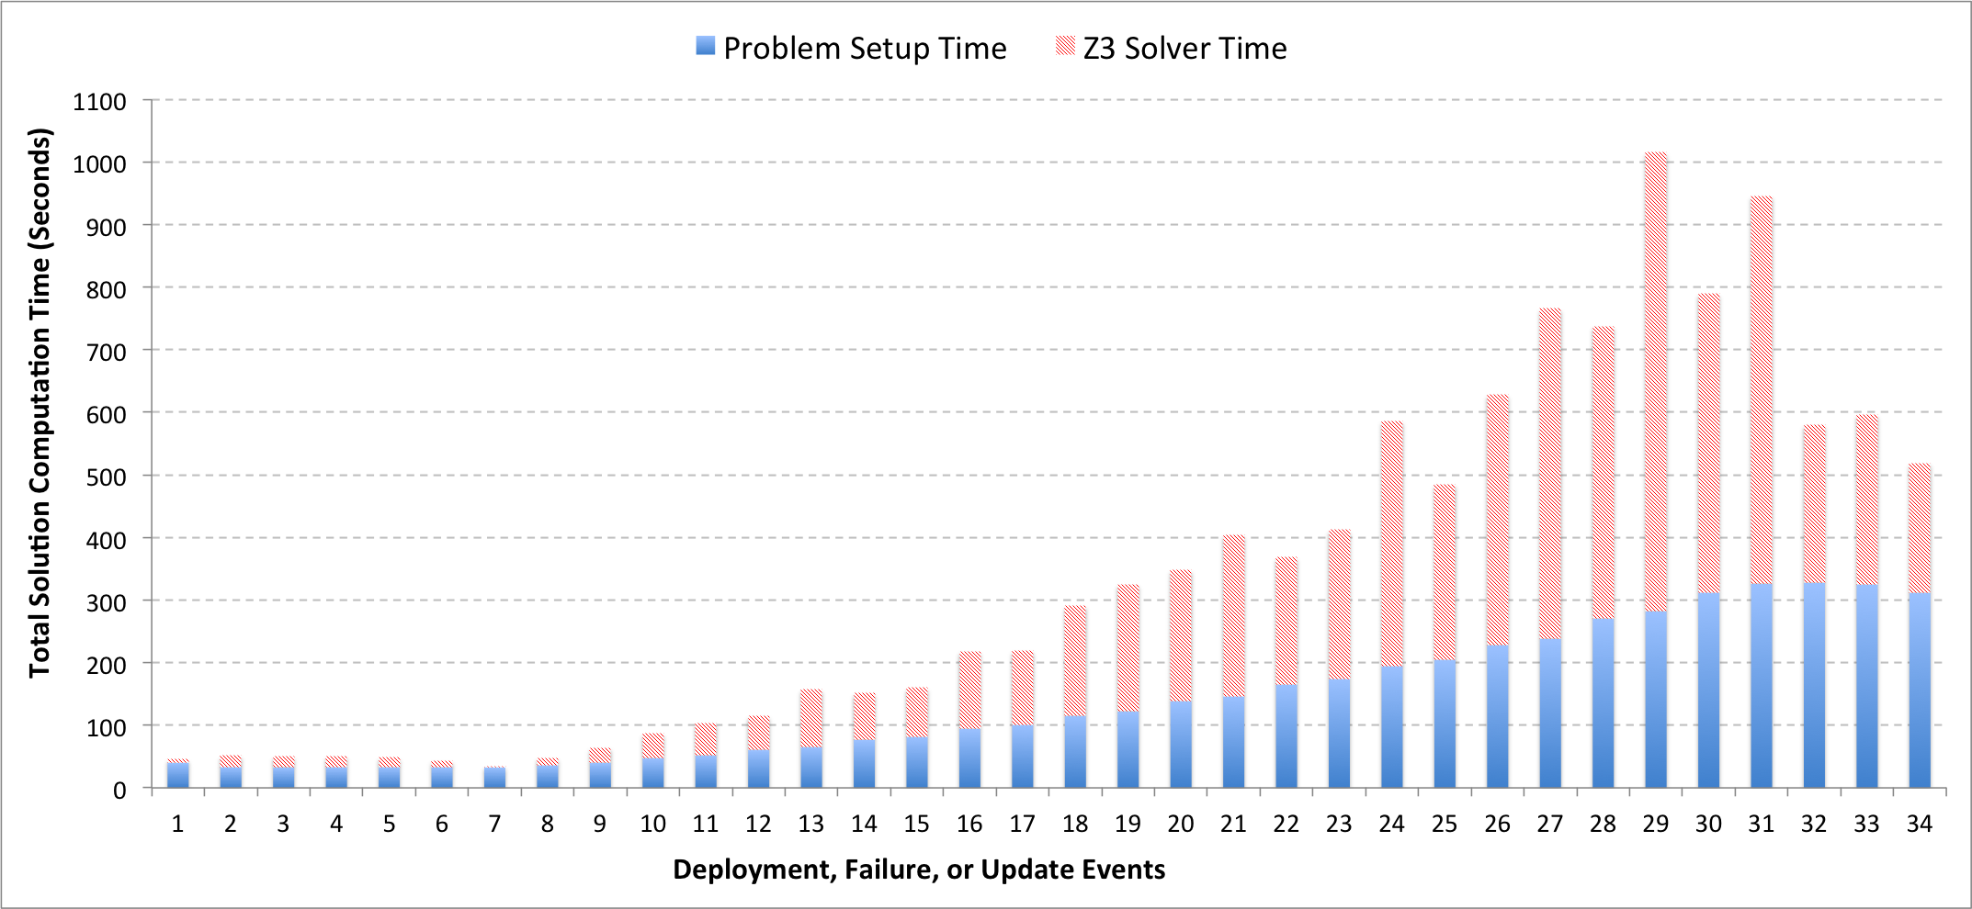
Evaluating CPC Algorithm
Initial deployment of the Smart Parking System over 21 nodes (11 camera nodes, 11 processing nodes, 1 terminal node)
Results in 23 component instances
occupancy_detector replicated as a cluster with replication range 7 - 10
Notes:
23 components: 11 image_capture (per node with camera nodes), 10 occupancy_detector, 1 load_balancer, 1 parking_manager

Slide 38
Evaluating CPC Algorithm
6 consecutive node failure events (1 failure per event) resulting in 15 nodes and 18 component instances
6th failure (event 7) is the failure of the only available terminal node, which results in system not being able to reconfigure itself

Slide 39
Evaluating CPC Algorithm
24 consecutive hardware update events (1 node addition per event); 2 terminal nodes, 11 processing nodes, and 11 camera nodes
Results in 39 nodes and 31 component instances

Slide 40
Evaluating CPC Algorithm
3 consecutive node failure events resulting in 36 nodes and 30 component instances

Slide 41
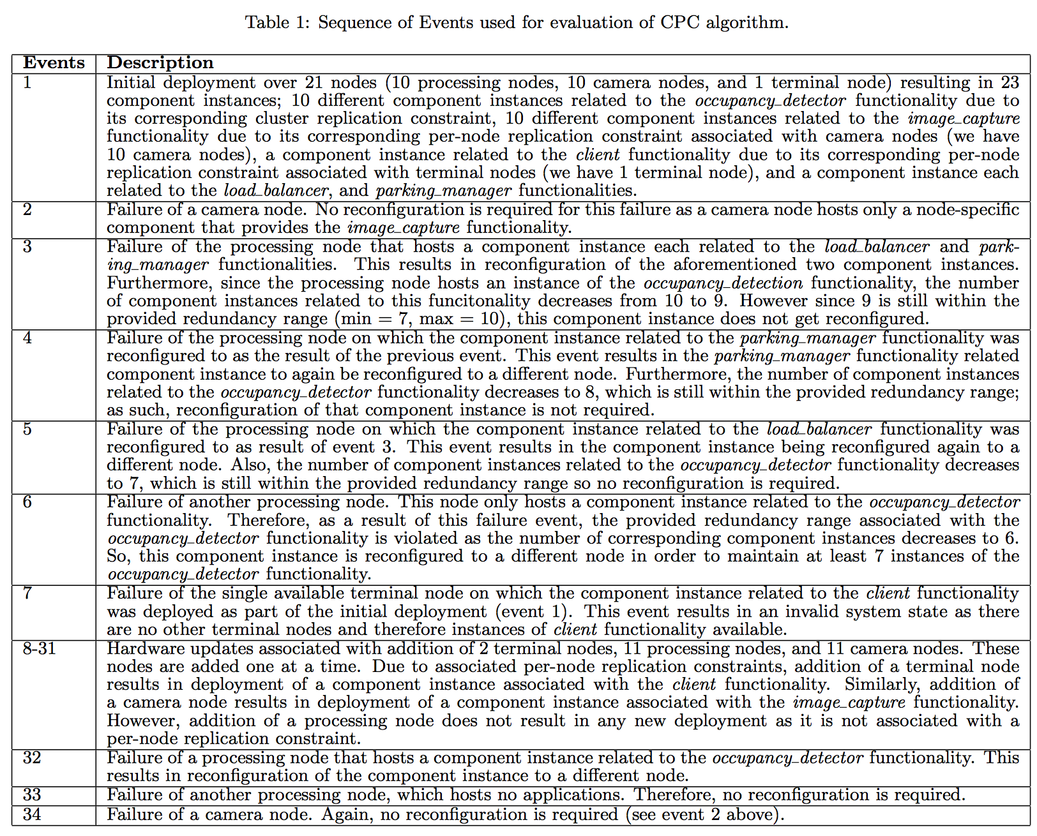

Slide 42
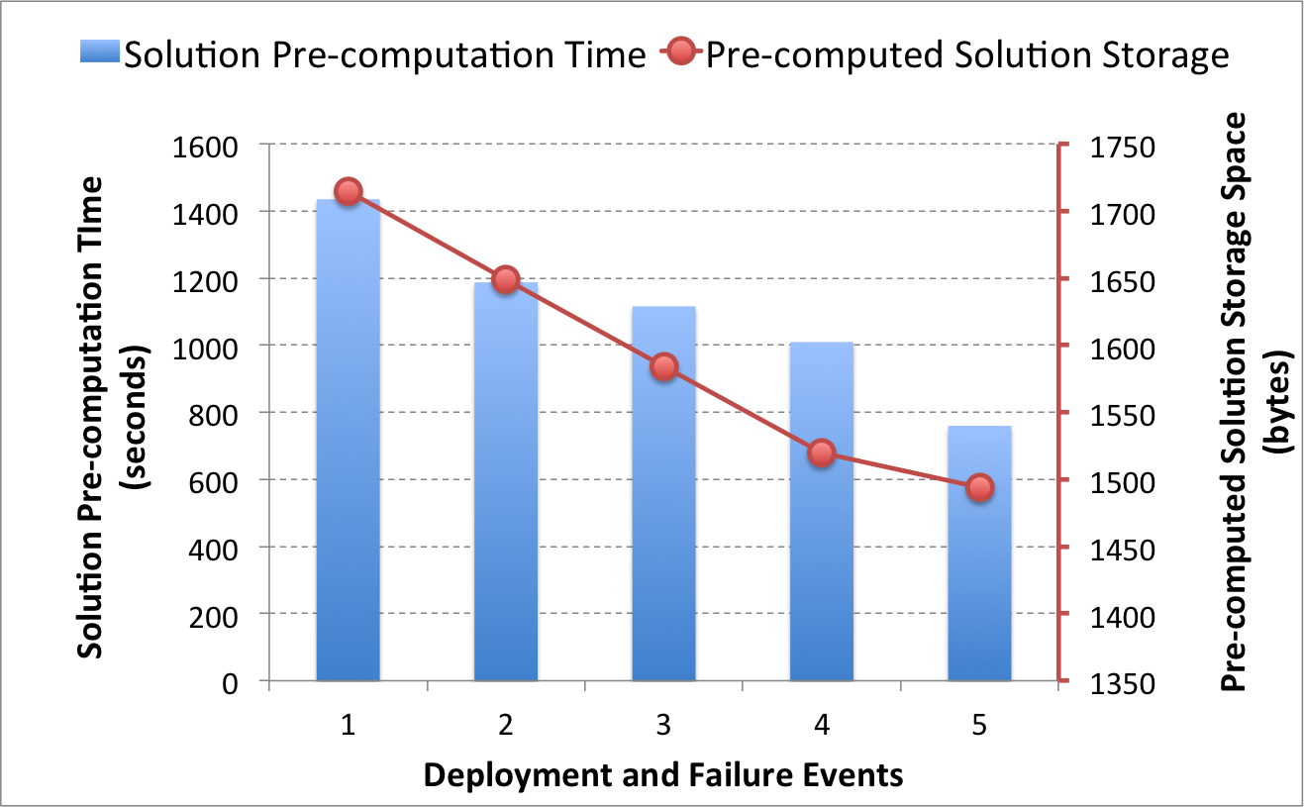
Evaluating Look-ahead Algorithm
Graph above shows solution pre-computation time. The actual solution finding time is insignificant due to pre-computation and is equivalent to database lookup time (average over first five events was 8.5 milliseconds)

Slide 43
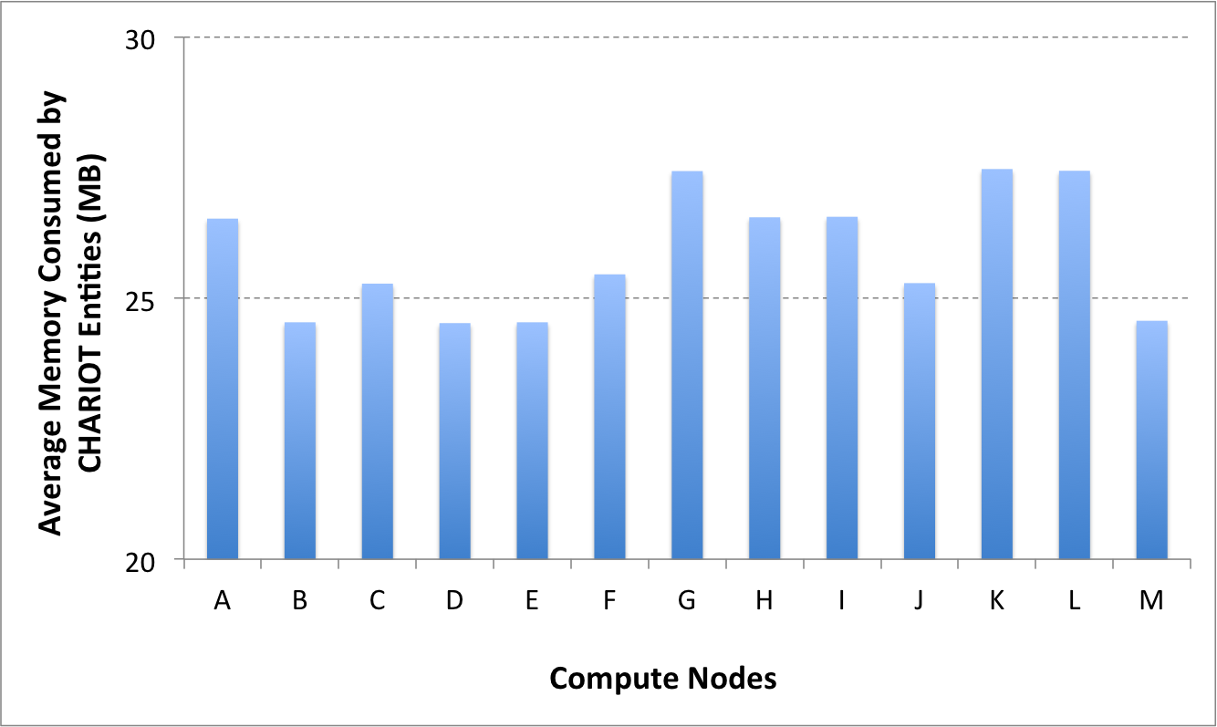
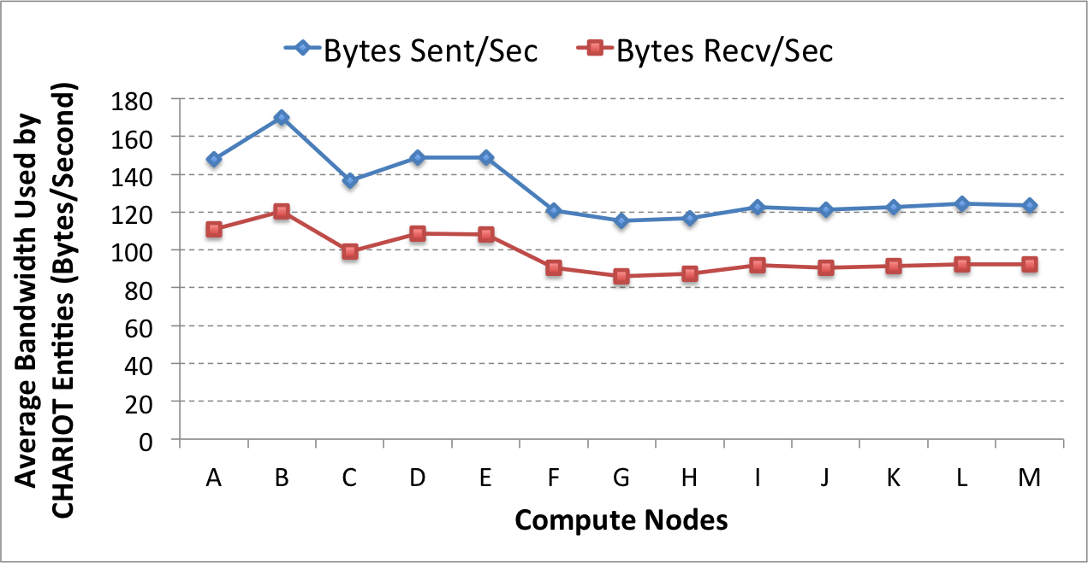
CHARIOT Resource Consumption on Edge Nodes
A, B, C, D, E – Nodes with short lifetime (less than 15 minutes)
F, G, H, I – Nodes with medium lifetime (between 110 – 154 minutes)
J, K, L, M – Nodes with long lifetime (between 200 – 235 minutes)
Notes:
Resource consumed by Node Monitors and Deployment Managers

Slide 44
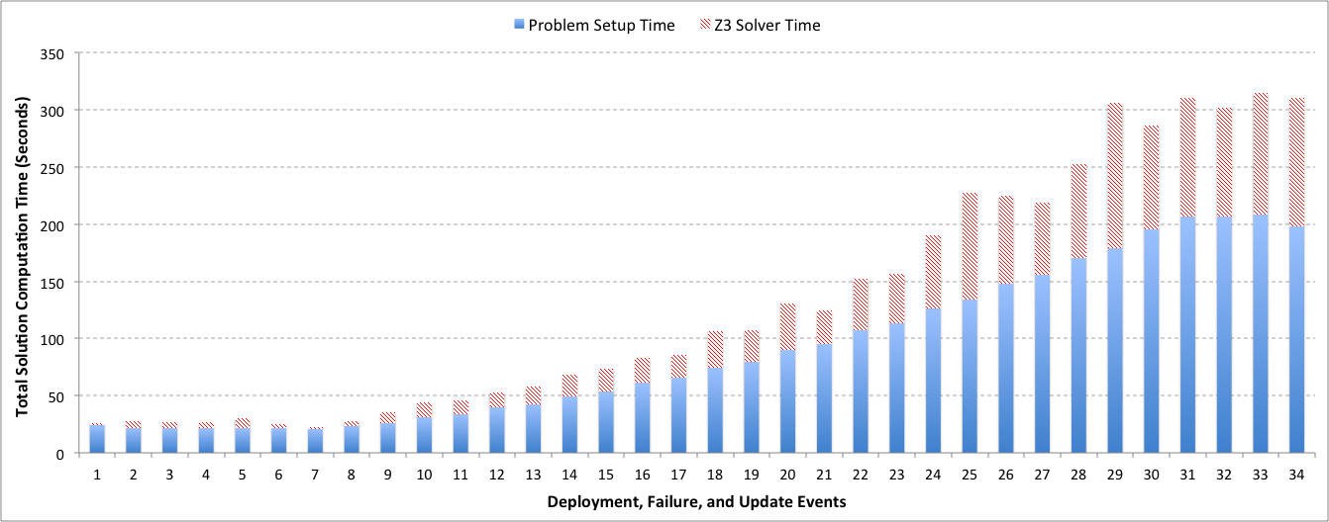
Analyzing CPC Algorithm
Experiment simulated in a single computer
OS: Windows 7, 64 bit (Non-simulated: Ubuntu)
Memory: 8 GB (Non-simulated: 4GB)
No. of cores: 8 (Non-simulated: 2)

Slide 45
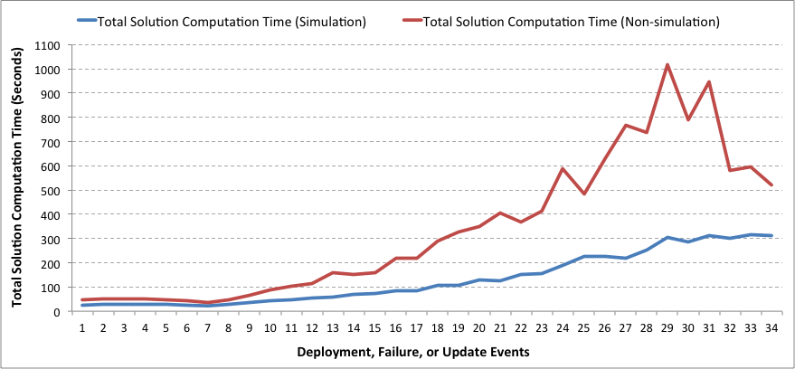
Analyzing CPC Algorithm
Experiment simulated in a single computer
OS: Windows 7, 64 bit (Non-simulated: Ubuntu)
Memory: 8 GB (Non-simulated: 4GB)
No. of cores: 8 (Non-simulated: 2)

Slide 46
Analyzing CPC Algorithm:
Z3 Solver Time Jitter

Slide 47
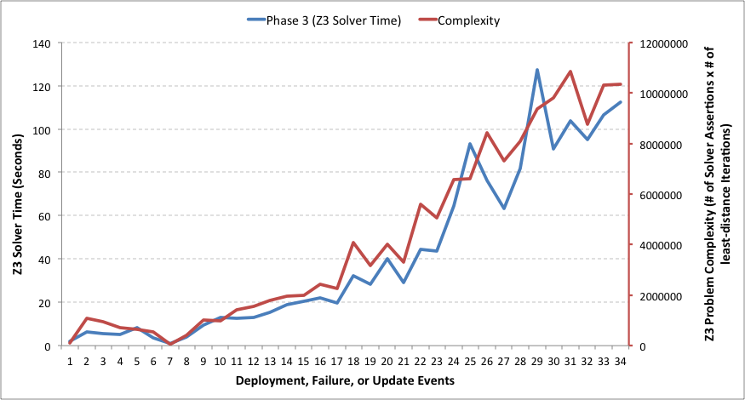
Analyzing CPC Algorithm:
Z3 Solver Time Jitter

Slide 48
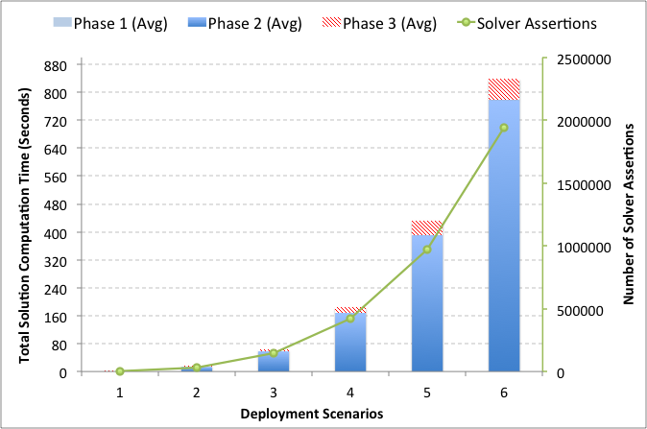
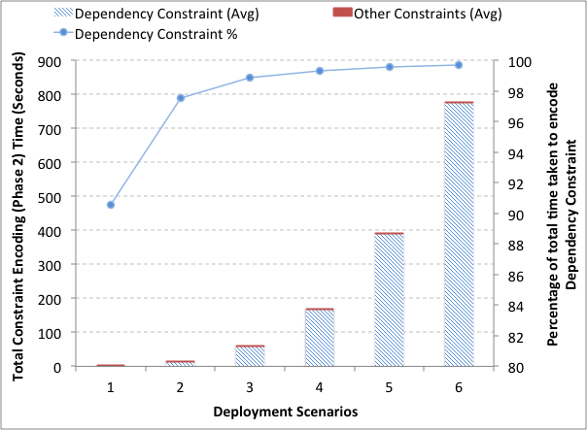
Analyzing CPC Algorithm using Initial Deployment Computation Time
Scenario | Nodes, Components
1 | 11, 10
2 | 22, 18
3 | 33, 26
4 | 44, 34
5 | 55, 42
6 | 66, 50
Nodes
Nodes
Notes:
Dependency constraint analysis: For each dependency, O(n^2)

Slide 49
Lessons Learned
Requirements to support autonomous resilience for extensible CPS
Failure avoidance
Failure management
Operations management
CHARIOT provides a holistic solution
A generic system description mechanism (design-time)
Failure avoidance using well-defined redundancy patterns
Failure and operations management facilitated via dynamic reconfiguration mechanism (runtime)
Different kinds of applications necessitates different resilience mechanisms
Redundancy patterns: dynamic real-time applications that are subject to frequent changes and failures
CPC with look-ahead: (soft) real-time applications
Default CPC: non real-time applications
Dynamic reconfiguration is time consuming
Current implementation of CHARIOT can be improved in different ways
Efficient dependency constraints encoding (responsible for more than 90% of the problem setup time)
Limiting the number of least-distance iteration to reduce Z3 solver time
Replace one-step look ahead by implementing a N-step look-ahead algorithm
Notes:
CHARIOT source code available on GitHub. Full release in the coming weeks (by the end of this month).

Slide 50
Relevant Publications
Subhav Pradhan, Abhishek Dubey, Shweta Khare, Saideep Nannapaneni, Aniruddha Gokhale, Sankaran Mahadevan, Douglas C Schmidt, and Martin Lehofer. CHARIOT: A Holistic, Goal Driven Orchestration Solution for Resilient IoT Applications. ACM Transactions on Cyber-Physical Systems. (Under review)
Subhav Pradhan, Abhishek Dubey, Tihamer Levendovszky, Pranav Kumar, William Emfinger, Daniel Balasubramanian, William Otte, and Gabor Karsai. Achieving Resilience in Distributed Software Systems via Self-Reconfiguration. Journal of Systems and Software (JSS 2016).
Subhav Pradhan, Abhishek Dubey, Aniruddha Gokhale, and Martin Lehofer. WiP Abstract: Platform for Designing and Managing Resilient and Extensible CPS. Proc. of the 7th International Conference on Cyber-Physical Systems (ICCPS 2016), pages 1 - 1, Vienna, Austria.
Subhav Pradhan, Abhishek Dubey, Aniruddha Gokhale, and Martin Lehofer. CHARIOT: A Domain Specific Language for Extensible Cyber-Physical Systems. The 15th Workshop on Domain-Specific Modeling (DSM 2015), pages 9 - 16, Pittsburgh, Pennsylvania, USA.

Slide 51






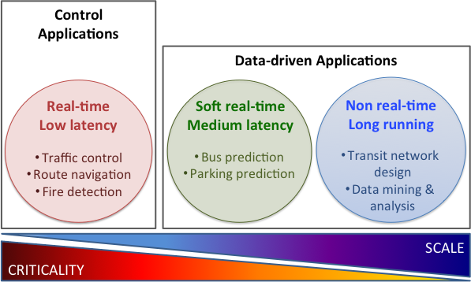
Future Research Direction
High degree of hardware and software heterogeneity in extensible CPS
Middleware resolves hardware heterogeneity but there exists multiple middleware solutions
Different middleware solutions appropriate for different domains
Extensible CPS like smart cities requires collaboration between multi-domain, heterogeneous applications
Requirements:
Interaction between heterogeneous applications while remaining agnostic to the underlying middleware
Proposed solution: A generic, middleware agnostic computation model
LCM

Slide 52
Computation Patterns for Different types of Applications
Time-driven component assembly
CBSE approach
Based on well-defined component model
Business logic triggered periodically (based on timers) or reactively (based on external events/messages)
Stream or batch processing
Stream processing for soft real-time applications
Stream/batch processing for non real-time applications

Slide 53
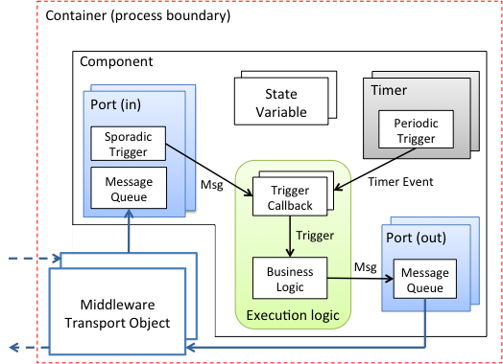
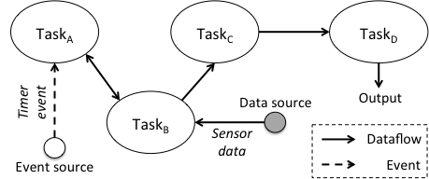
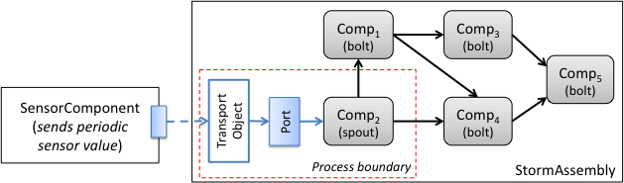
A Generic Computation Model
For control applications
A Computation Graph
Provides clean separation-of-concerns between computation and communication logic
A Component Model
A Component Assembly Comprising a Sensor Component and a Storm Topology
Subhav Pradhan, Abhishek Dubey, Sandeep Neema, and Aniruddha Gokhale. Towards a Generic Computation Model for Smart City Platforms. The 1st International Workshop on Science of Smart City Operations and Platforms Engineering (SCOPE 2016), pages 1- 6, Vienna, Austria.

